Slide 1
Sports Performance Analytics
HES 3000-002
Saryu Onishi

Slide 2
Welcome!
Modern sports generate enormous amounts of data.
Having data is not the same as knowing:
What it means
What matters
What to do next
This course is about turning sports data into knowledge and insights that can guide decisions.

Slide 3
What Will We Do in This Course?
Translate sports intuition into answerable analytical problems.
Extract and summarize information from performance data.
Make comparisons, analyze patterns / trends and build basic statistical models.
Visualize and communicate findings for sport performance audiences.
Evaluate assumptions, limitations, bias, and uncertainty in analytical claims.

Slide 4
The Scope of HES 3000
We are interested in questions related to:
Scouting, recruiting, and roster decisions
Athlete performance and training
Strategy and competition
We are not working on sports business problems
Ticketing
Marketing and sponsorship
Operations

Slide 5
Before we get too far …

Slide 6
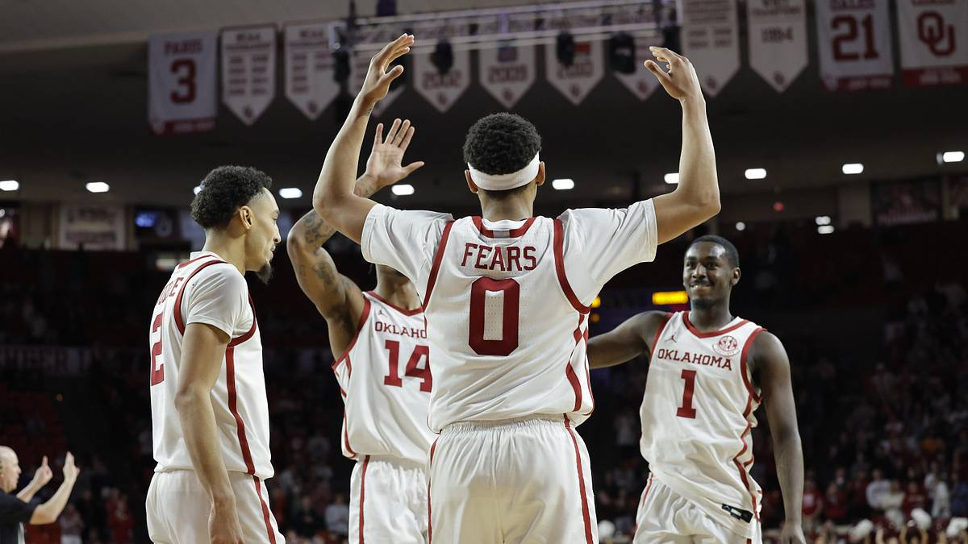


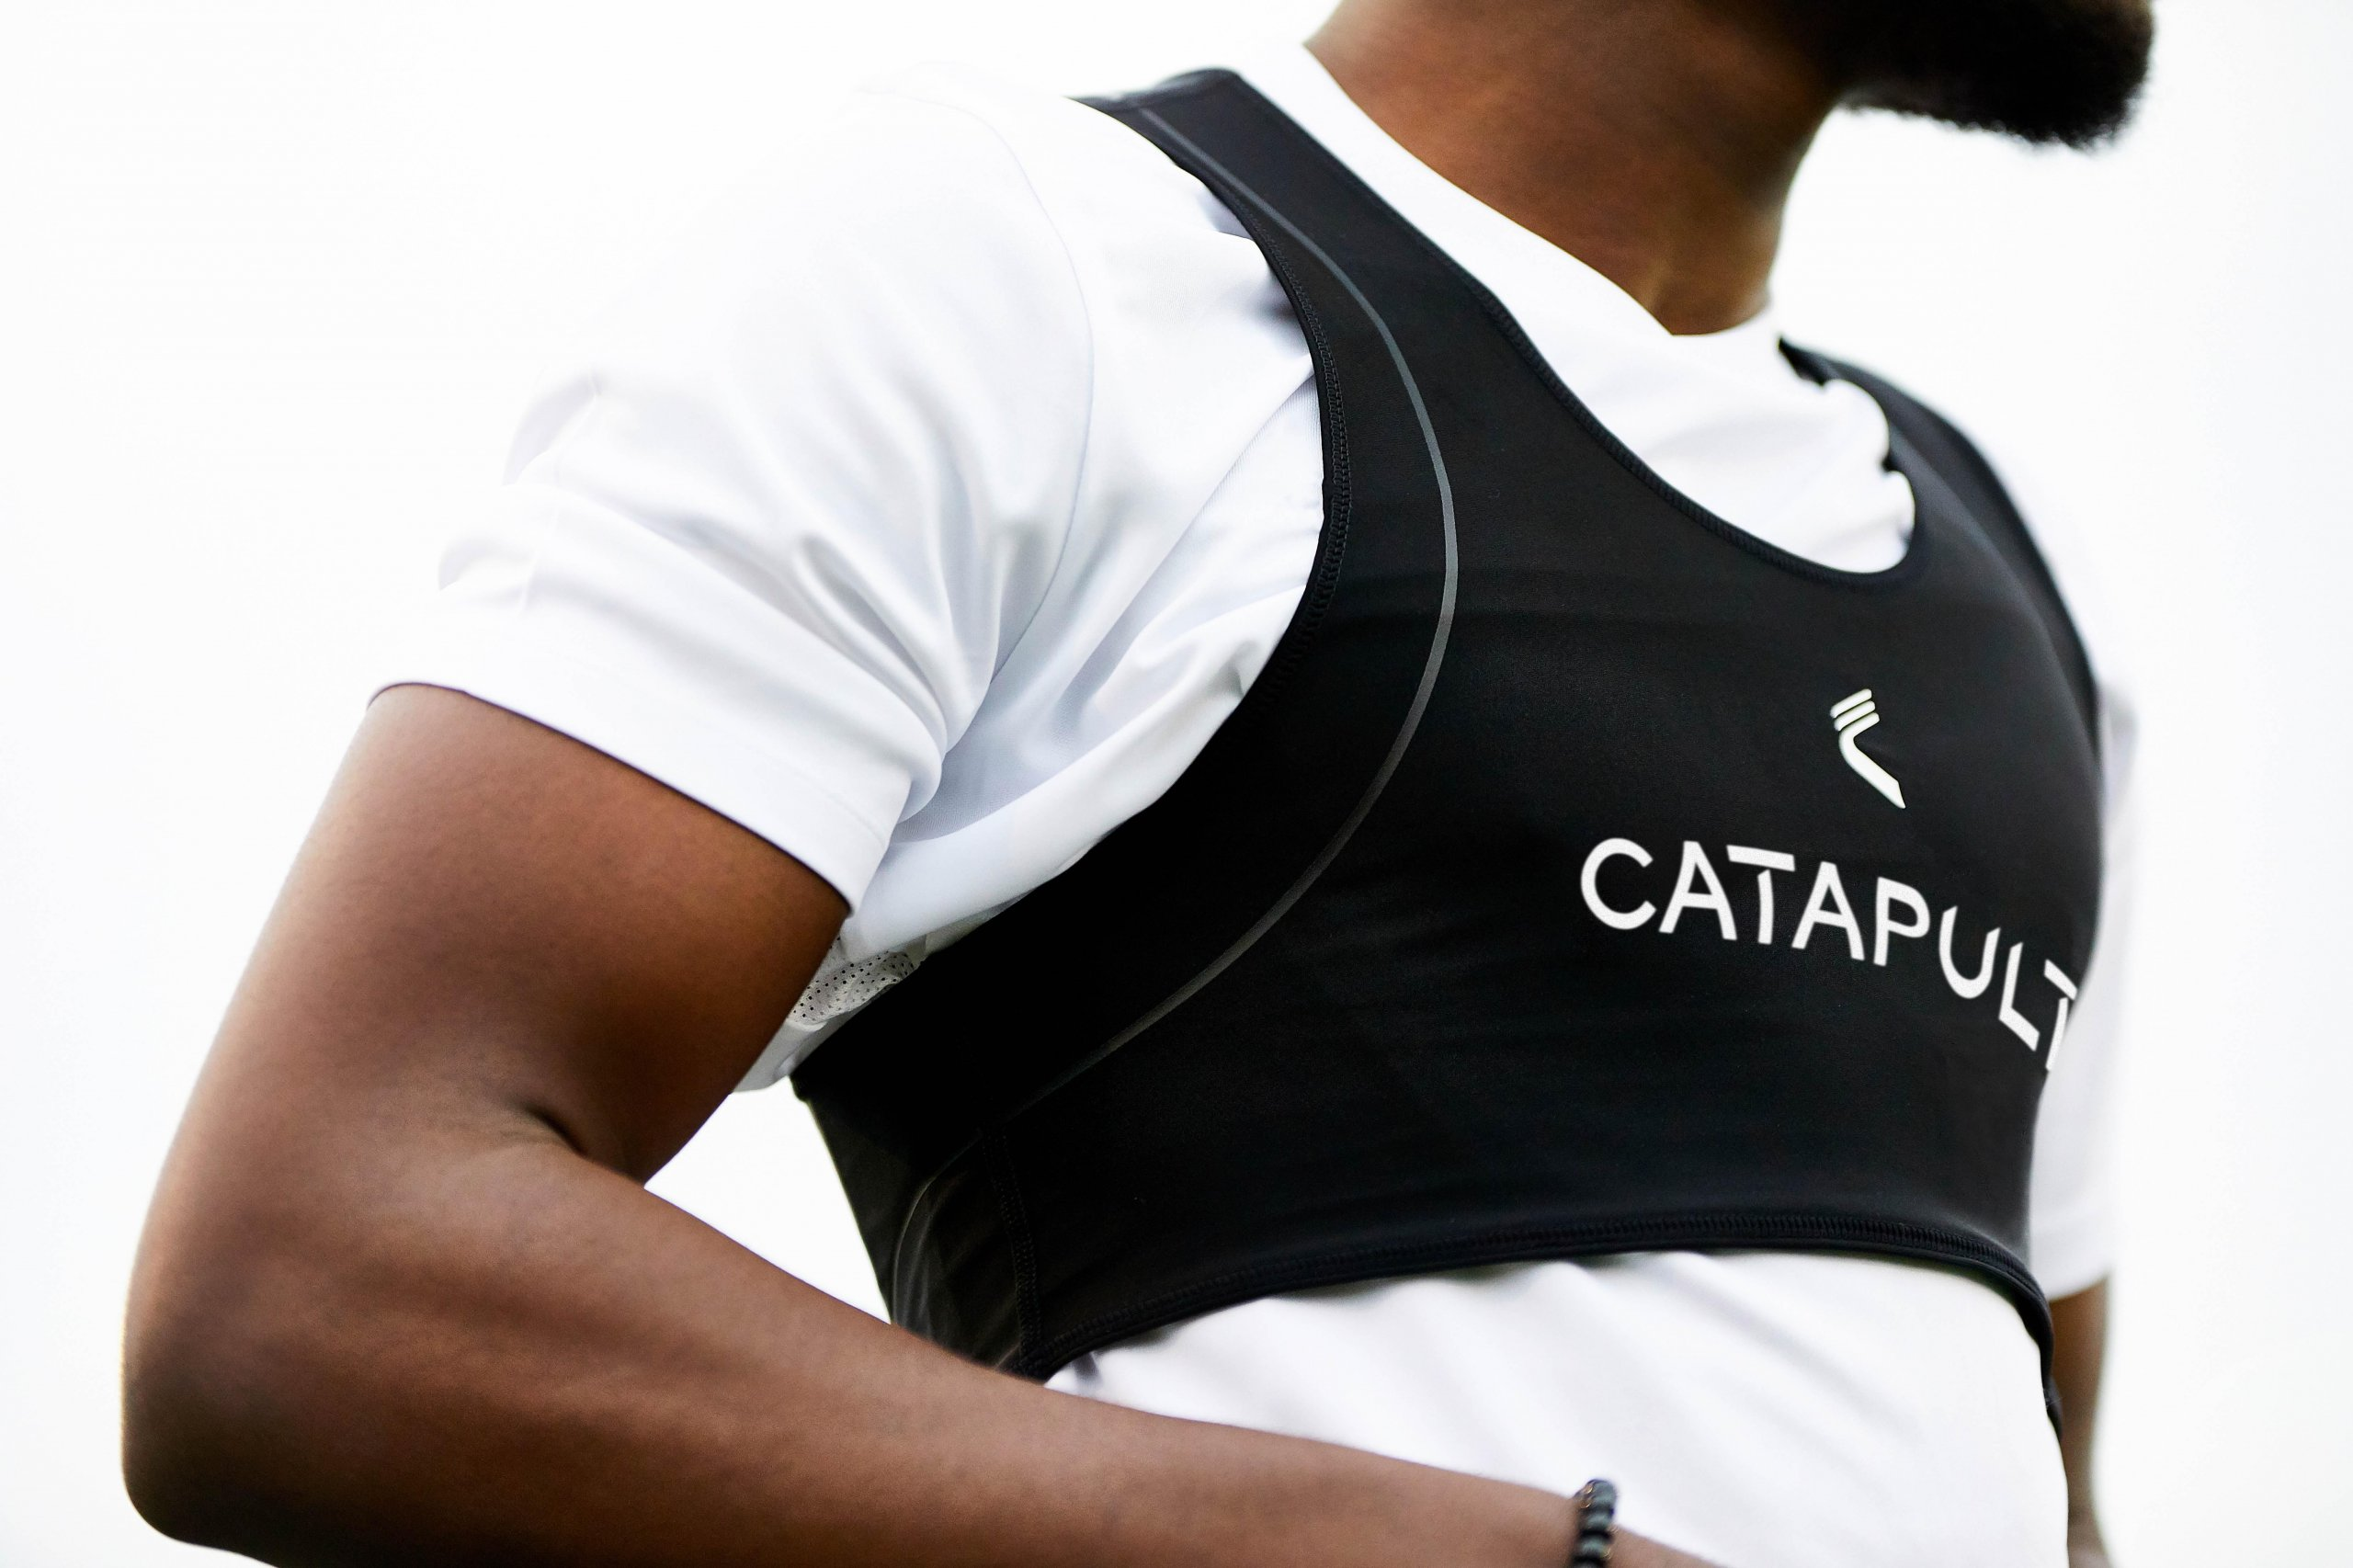
About me
Sports Data Analytics MSc
Exercise Physiology PhD candidate
Sport science, Oklahoma Basketball
Performance Intern, Vegas Golden Knights
What I work on
Load management using wearable technology
Translating data into actionable coaching insight

Slide 7
Tell me about yourself!
In your index cards:
Name
Year + Major
Favorite sport / team
One thing you're interested in learning from this class
Notes:
To help me remember you

Slide 8
Brainstorming Activity
Jot down a few questions you have had about sports performance:
Watching a game or competition
Playing, coaching, or training for a sport
Comparing athletes
Following recruiting or roster decisions
Hearing a sports claim that seemed questionable
Possible starting phrases:
“I have always wondered why…”
“How could a team determine whether…”
“How would we know if…”
“Should a coach…”

Slide 9
Pair and Share
In groups of 3:
Give each person an opportunity to share.
Select one or two ideas to discuss further.
For each selected idea, consider:
What information do we need to answer your question?
What decisions would the answer effect?
What are some possible answers to your questions?
What are the risks and benefits of change?

Slide 10
Brainstorming Activity
The questions you generated today involve different:
Sports and competitive settings
Types of data
Analytical approaches
Audiences and decisions
Throughout the semester, we will develop a framework for investigating them systematically.

Slide 11
Skills to Build during this semester
Analytics foundations:
What sport analytics is and formulating good questions we can answer
Data:
Sources, structure, quality, validity, reliability, and ethics
Describe data:
Center, spread, distributions, and athlete profiling
Visualize data:
Showing patterns clearly and honestly
Explore relationships:
Association, regression, and interpretation
Making decisions:
Thresholds, probabilities, models, and communication
Application:
A semester-long group project
Notes:
This is general structure
Personal story: Similar class immediately started with case studies
Interesting but did not equipt me with the knowledge of how its done
My aim is to go over the steps and then later discuss how this is applied irl

Slide 12
Assessments
12 quizzes:
Review the previous week's material; the two lowest scores are dropped.
In-class activities:
Apply concepts to sports problems and earn participation credit.
> 80% completion = 10 pts, 60-79% completion = 5 pts, < 60% completion = 0.
4 case studies:
Interpret data, evaluate methods, visualize findings, and reflect on analytical choices.
Journal article discussion:
Present and discuss peer-reviewed sport analytics research.
2 exam:
Demonstrate your understanding of concepts, applications, and the final project.
Notes:
Quizzes: due each Sunday
In-class activities:
Case studies:
Journal article presentation
Analytics project: think about a topic as we go through content
Exams: requires lockdown browser

Slide 13
Assessments
Evaluation | Points | Weight
Quizzes (10) | 100 | .20
Attendance | 10 | .02
Case study (4) | 80 | .16
Journal article discussion | 10 | .02
Final project | 100 | .2
Exams (2) | 200 | .4
Total | 500
Notes:
Point disctibution
Available in syllabus

Slide 14
Course policies
Attendance
In-class activities count toward attendance and cannot be made up.
Grade rounding at the end of the semester is only applied if full attendance points is earned.
Deadlines:
Late quizzes and exams are not accepted.
Other late work loses 10% per day unless arranged in advance.
*Check syllabus for full details
Notes:
Groups: If there are issues, please speak to me asap

Slide 15
Resources
Canvas
All materials used in this course will be available on Canvas
Class-wide communications will be done via Canvas Announcements
Communication
Email: saryu@ou.edu (DO NOT message me on Canvas)
Office: SJSC 103 on Tuesdays at 1:30-2:30 or by appointment
Help me help you - please reach out if you need something from me!
Reasonable accommodation policy
All accommodations are facilitated through the Accessibility and Disability Resource Center.
If you require accommodations, contact adrc@ou.edu or (405)2325-3852.
Notes:
I do not get a sense of your understanding until the exams. Hence it is critical for you to reach out if you need help. If the slides look wrong or need clarification on anything, PLEASE email me or let me know in class. This is the only way I can help you

Slide 16
Looking Ahead
Next Class: Evolution of sports analytics
Before Next Class:
Read the syllabus
Get familiar with Moneyball, by Michael Lewis

